Slide 1
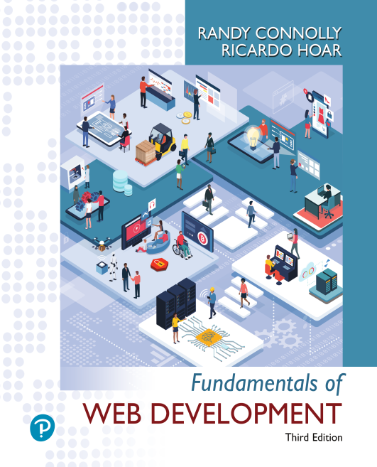

Fundamentals of Web Development
Third Edition by Randy Connolly and Ricardo Hoar
Chapter 1
Introduction to Web
Development
Copyright © 2021, 2018, 2015 Pearson Education, Inc. All Rights Reserved

Slide 2
In this chapter you will learn . . .
About web development in general
The history of the Internet and World Wide Web
Fundamental concepts that form the foundation of the Internet
About the hardware and software that support the Internet
The range of careers and companies in web development

Slide 3
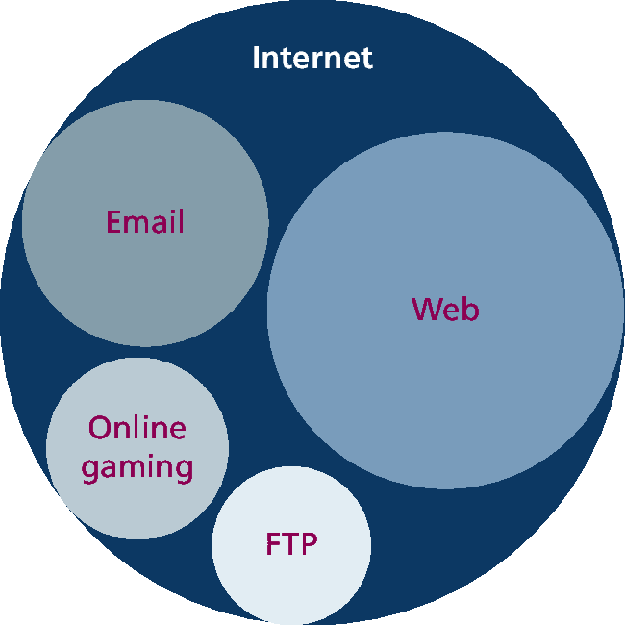
A Short History of the Internet
Know the difference between “Internet” and “WWW”
While this book is focused on the web, part of this chapter is also devoted to a broad understanding of that larger circle labeled the “Internet.”
Protocols define different kinds of interactions/services on the Internet

Slide 4
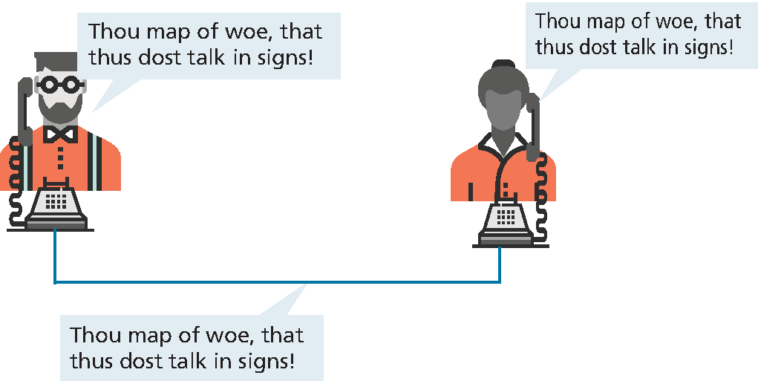
Circuit Switched Networks
Circuit switching in early networking
In the past, telephone calls were routed through operators who physically connected the caller and the receiver by connecting a wire to a switchboard to complete a circuit.
Inefficient use of bandwidth
Difficult to scale

Slide 5
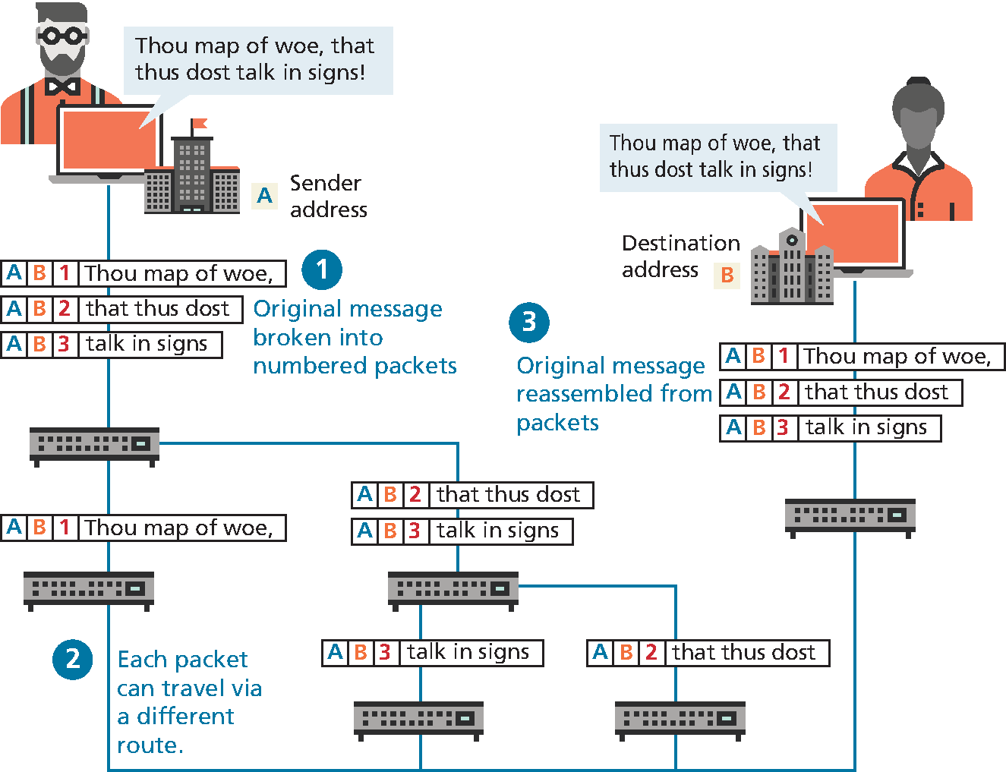
Packet Switched Networks
Packet switching came later, does not require a continuous connection
1960s ARPANET
1974 X.25
1979 USENET
1981 TCP/IP was introduced to unify disparate networks
On January 1, 1983, TCP/IP was adopted across all of ARPANET

Slide 6
The Birth of the Web
Sr. Tim Berners-Lee publishes the main features of the web we know today on 1992.
A Uniform Resource Locator (URL) to uniquely identify a resource on the WWW.
The Hypertext Transfer Protocol (HTTP) to describe how requests and responses operate
A software program (web server software) that can respond to HTTP requests.
Hypertext Markup Language (HTML) to publish documents.
A program (a browser) that can make HTTP requests to URLs and that can display the HTML it receives.

Slide 7
Web Applications in Comparison to Desktop Applications (1 of 2)
Advantages
They can be accessed from any Internet-enabled computer.
They can be used with different operating systems and browser applications.
They are easier to roll out program updates since only software on the server needs to be updated as opposed to every computer in the organization using the software.
They have a centralized storage on the server, which means fewer security concerns about local storage (which is important for sensitive information such as health care data).

Slide 8
Web Applications in Comparison to Desktop Applications (2 of 2)
Disadvantages
Requirement to have an active Internet connection
Security concerns about sensitive private data being transmitted over the Internet.
Concerns over the storage, licensing, and use of uploaded data.
Problems with certain websites not having an identical appearance across all browsers.
Restrictions on software from being installed and hardware from being accessed (like Adobe Flash on iOS).
additional plugins might interfere with JavaScript, cookies, or advertisements.

Slide 9
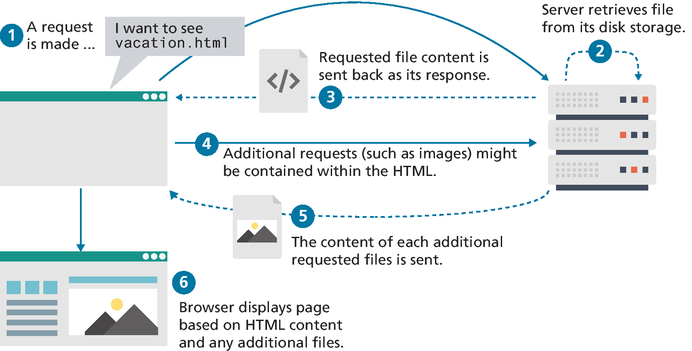
From Static to Dynamic (and Back to Static)
In the earliest days of the web, users could read the pages of a static website

Slide 10
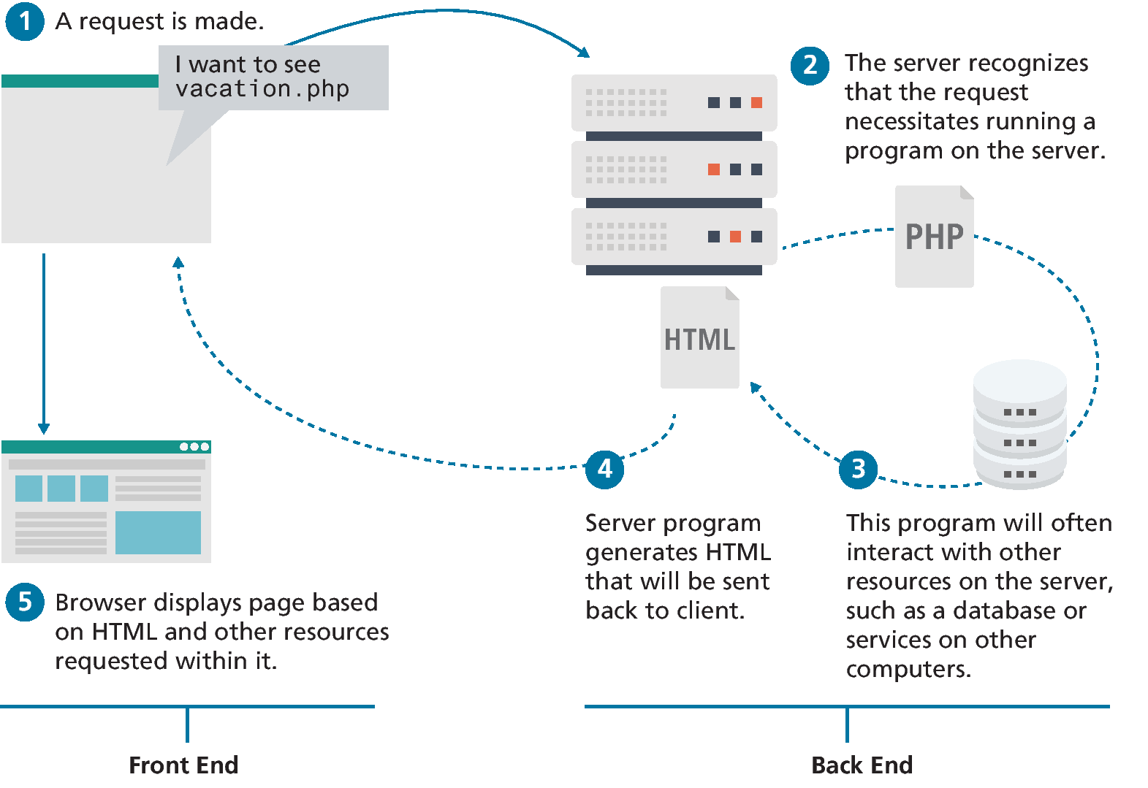
From Static to Dynamic (and Back to Static) ii
Later, programs running on web servers let websites generate content dynamically. This type of website is called a dynamic server-side website

Slide 11
Web 2.0
Web 2.0 referred to an interactive experience where users could contribute and consume web content, thus creating a more user-driven web experience.
For software developers, Web 2.0 also referred to a change in the paradigm. Programming logic, which previously existed only on the server, began to migrate more and more to the browser, which required learning JavaScript

Slide 12
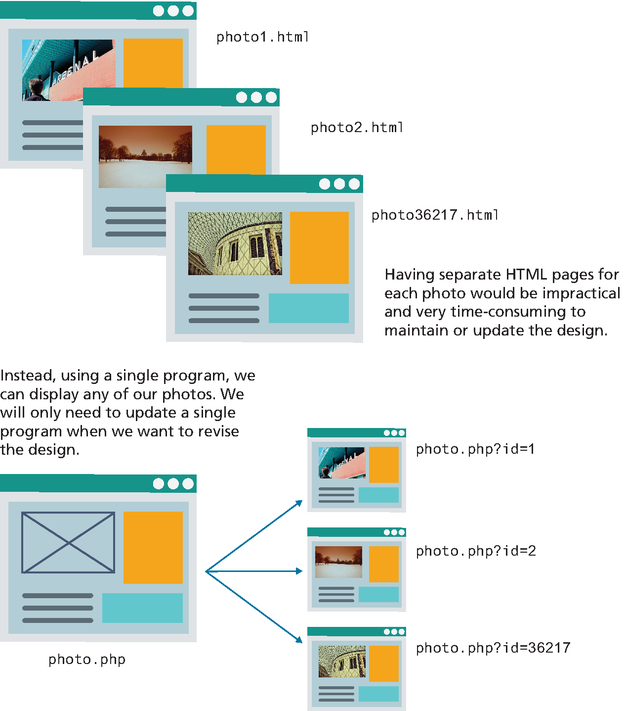
Why are programs needed? (1 of 2)

Slide 13
Why are programs needed? (2 of 2)

Slide 14
The evolution continues
Web development today is thus more complicated than it was when the first edition of this textbook was written in 2012–2013.
Early chapters on HTML and CSS teach layout and structural foundations.
JavaScript chapters focus on the fundamentals of the language and its usage within the browser.
While back-ends are thinner than they once were, server-side technologies are still essential.
Databases, state management, and authentication are all covered.
Management, security and configuration round out the advanced topics.
The one constant in the history of web development has been change

Slide 15
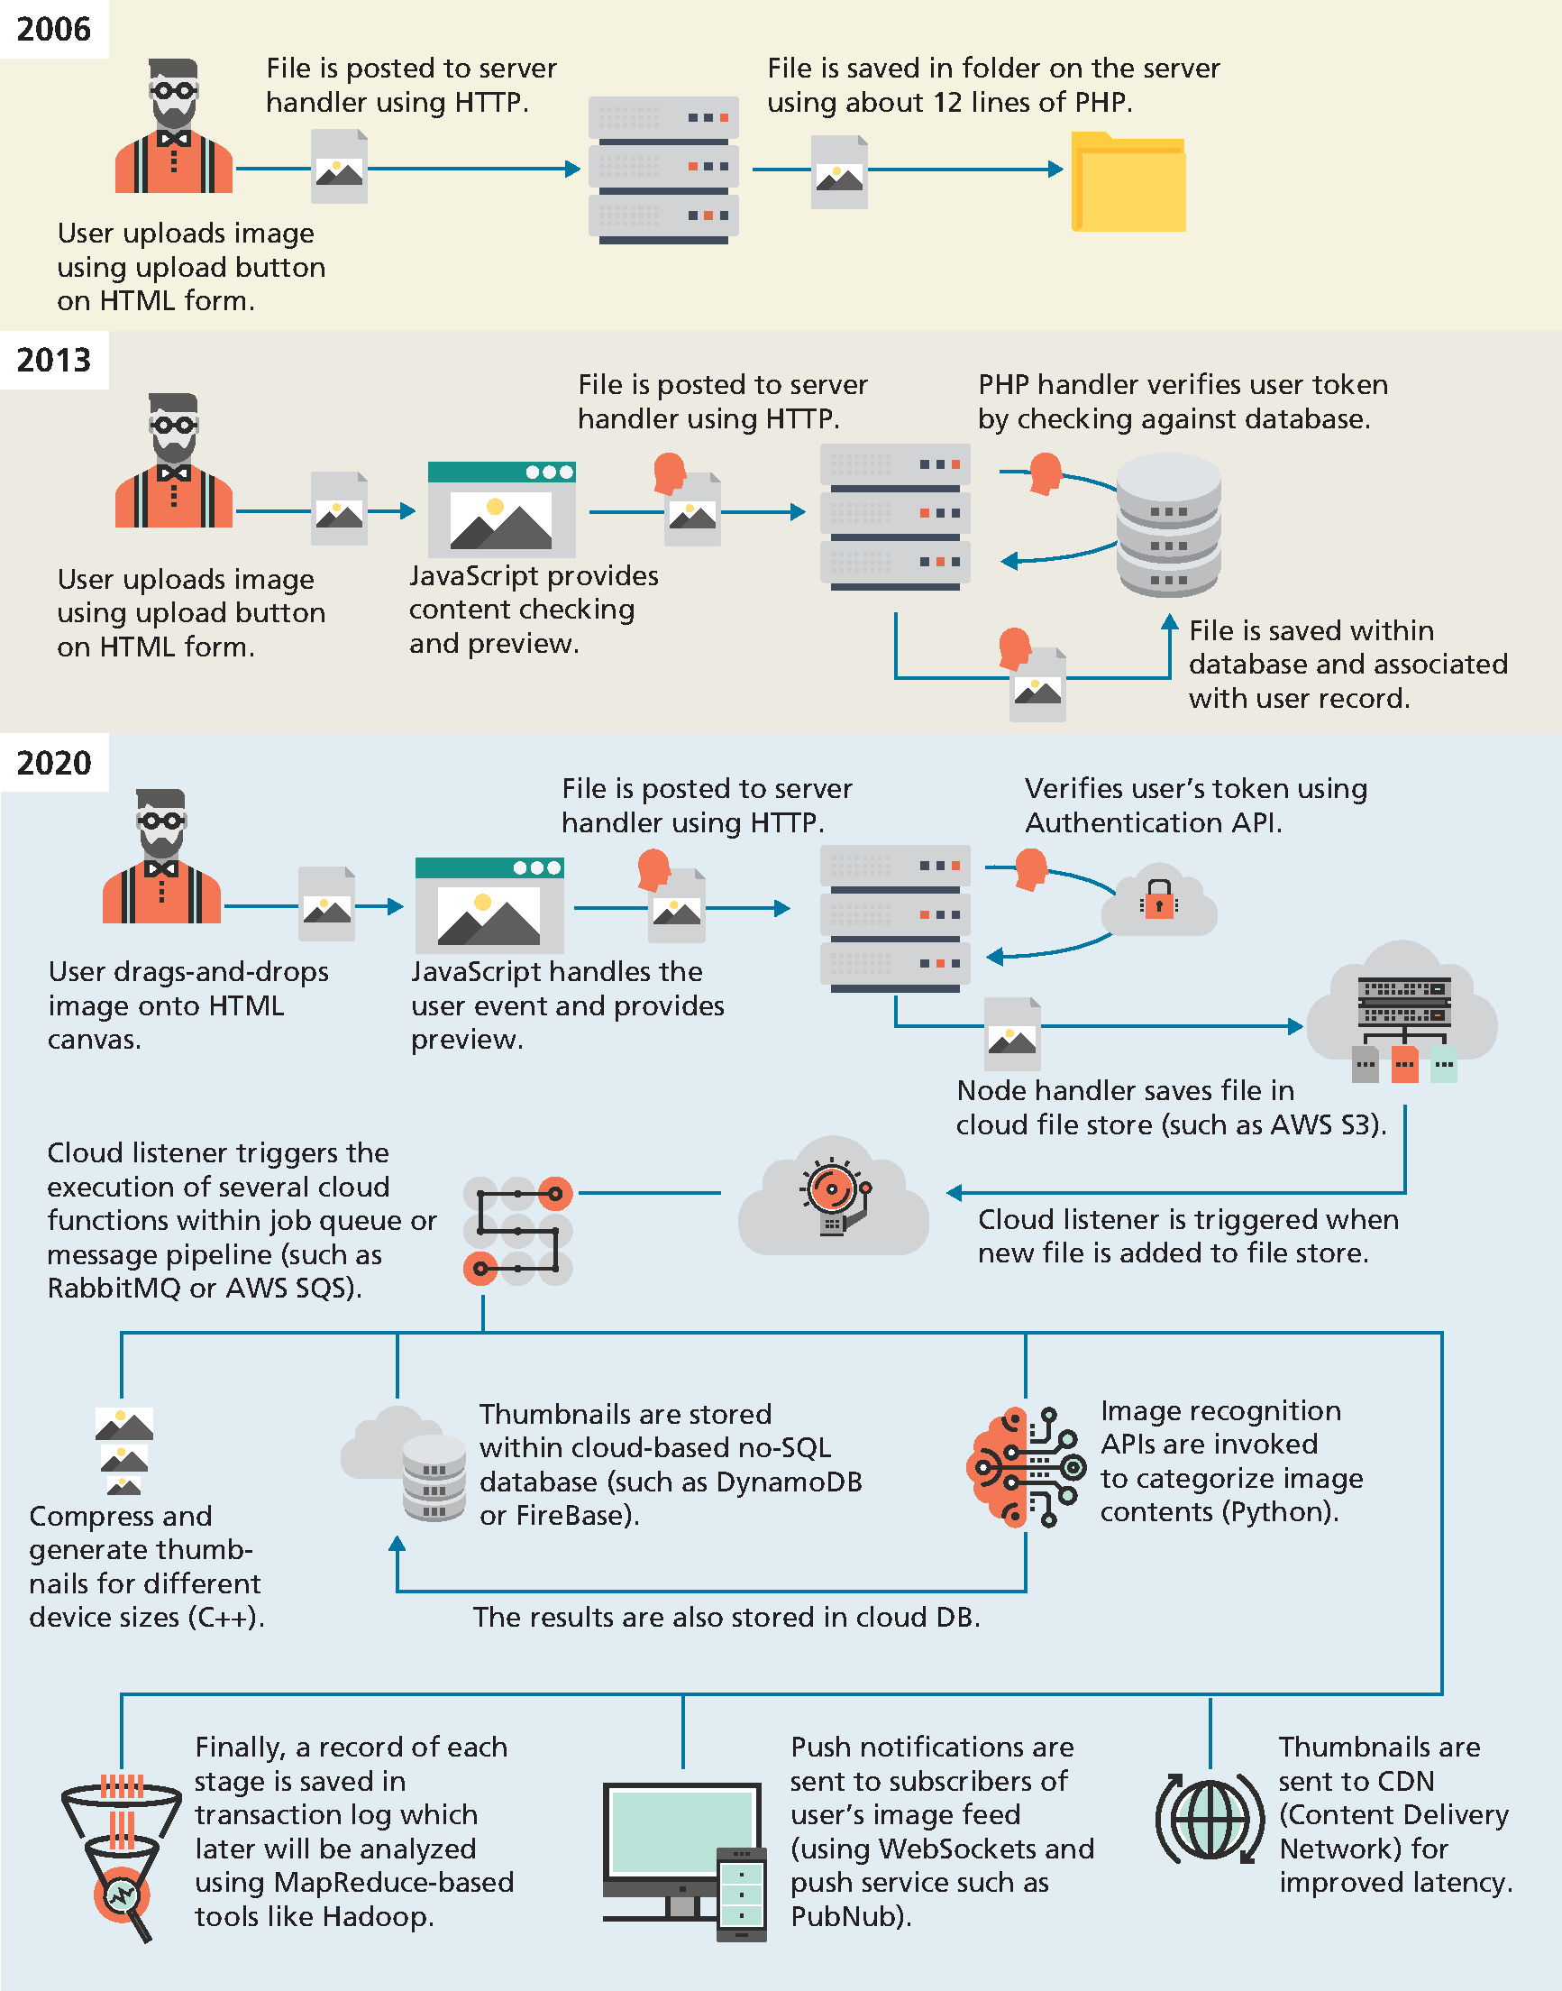
Evolving complexity example. File upload

Slide 16
Evolving complexity example (cont.)

Slide 17
The Client-Server Model
Client machines are the desktops, laptops, smart phones, and tablets you see everywhere.
Broad range of specifications regarding
operating system,
processing speed,
screen size,
available memory, and
storage
Server machines hosts web applications, stores user and program
data, and performs security authorization tasks
Powerful machines to handle high traffic and bandwidth.
The essential characteristic of a server is that it is listening for requests, and
upon getting one, responds with a message.

Slide 18
Server Types
Web servers.
Application servers.
Database servers.
Mail servers.
Media servers.
Authentication servers.

Slide 19
Real World Server Installations
Not one server, but a cluster of multiple machines working together.
Server Farm
Load Balancers
Failover Redundancy
Server Racks
Data Centers
Cloud Services

Slide 20
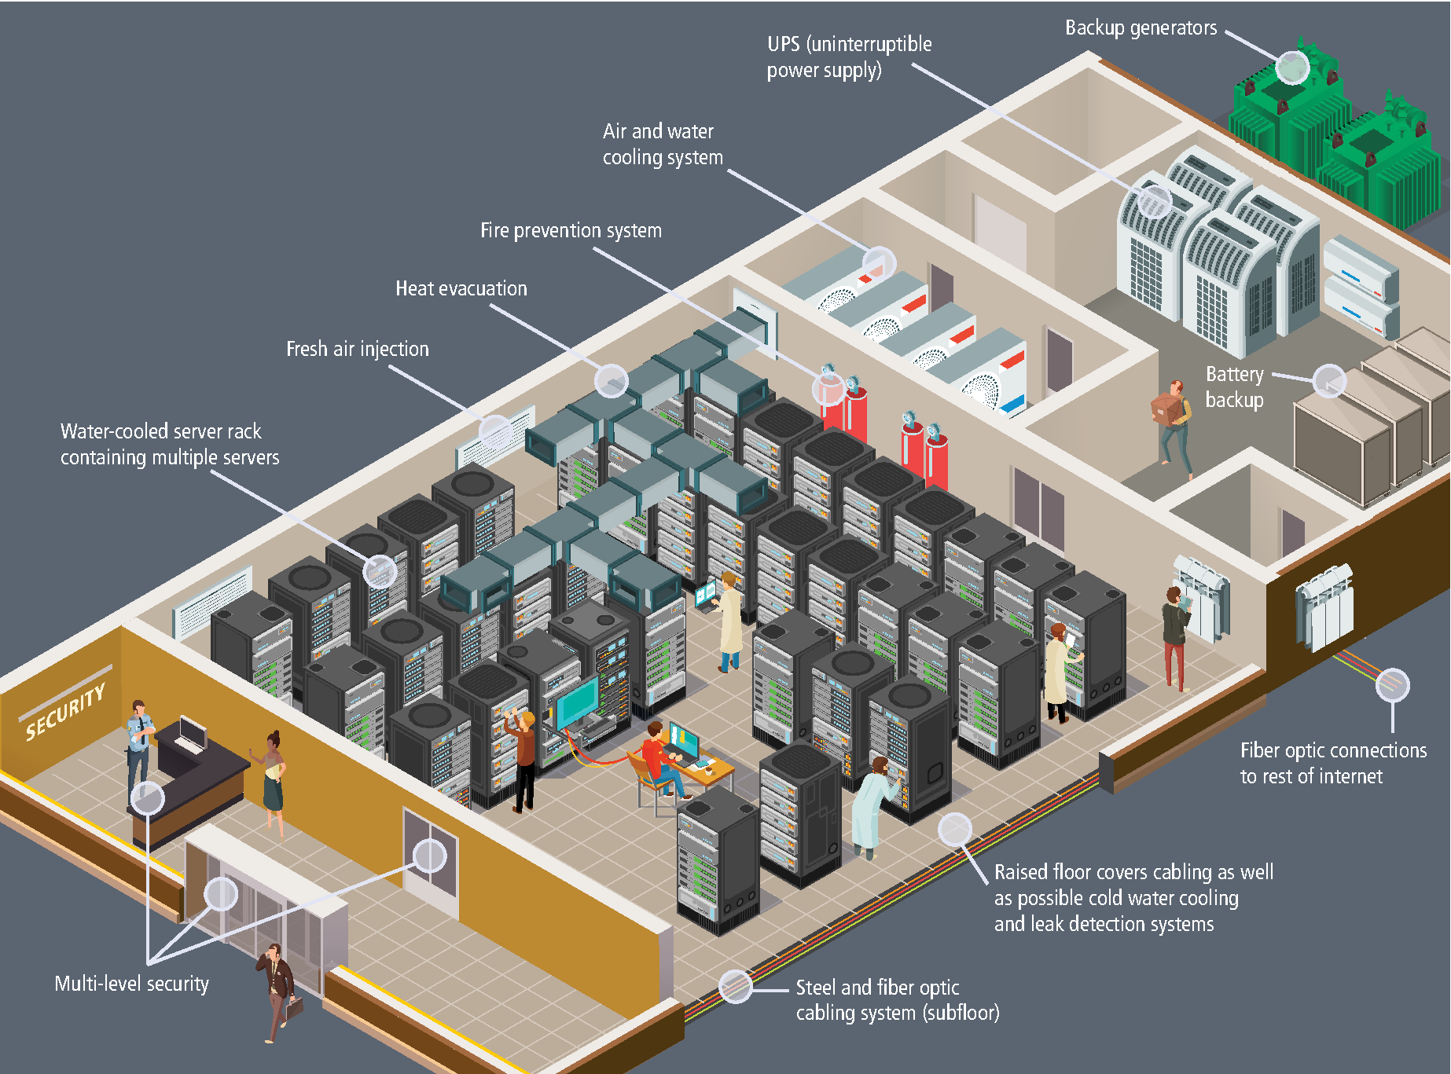
Hypothetical data center
Many additional considerations can be handled at a data center including:
Fire suppression,
Biometric security,
Failover data
Redundant power
and more!

Slide 21
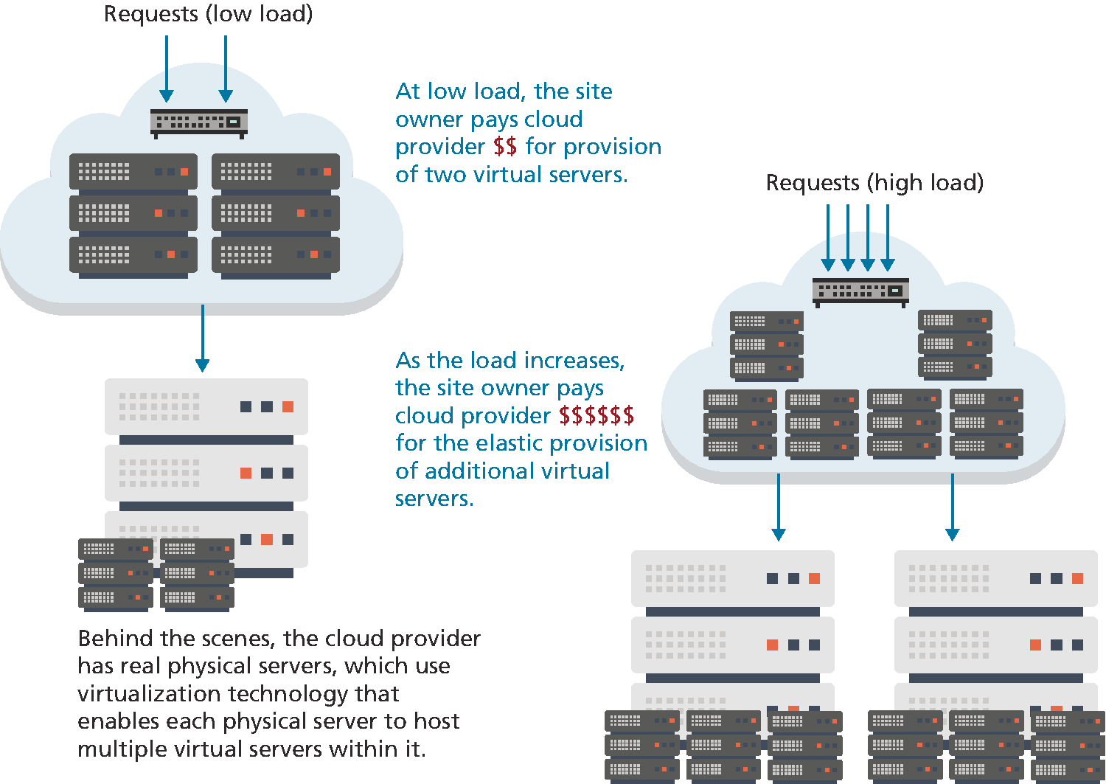
Cloud Servers
Instead of spending too much or spending too little to handle peak loads, cloud providers offer elastic provisioning of virtual servers, which scales costs and hardware to the demand

Slide 22
Where Is the Internet?
It is quite common for the Internet to be visually represented as a cloud Actually implemented via millions of miles of copper wires and fiber optic cables connecting millions of server computers and other networked devices!

Slide 23
From the Computer to Outside the Home
The broadband modem is a bridge between the network hardware outside the house and the network hardware inside the
house. These devices are often supplied by the ISP.
The wireless router is perhaps the most visible manifestation of the Internet in one’s home. At its simplest, a router is a hardware device that forwards data packets from one network to another network.

Slide 24
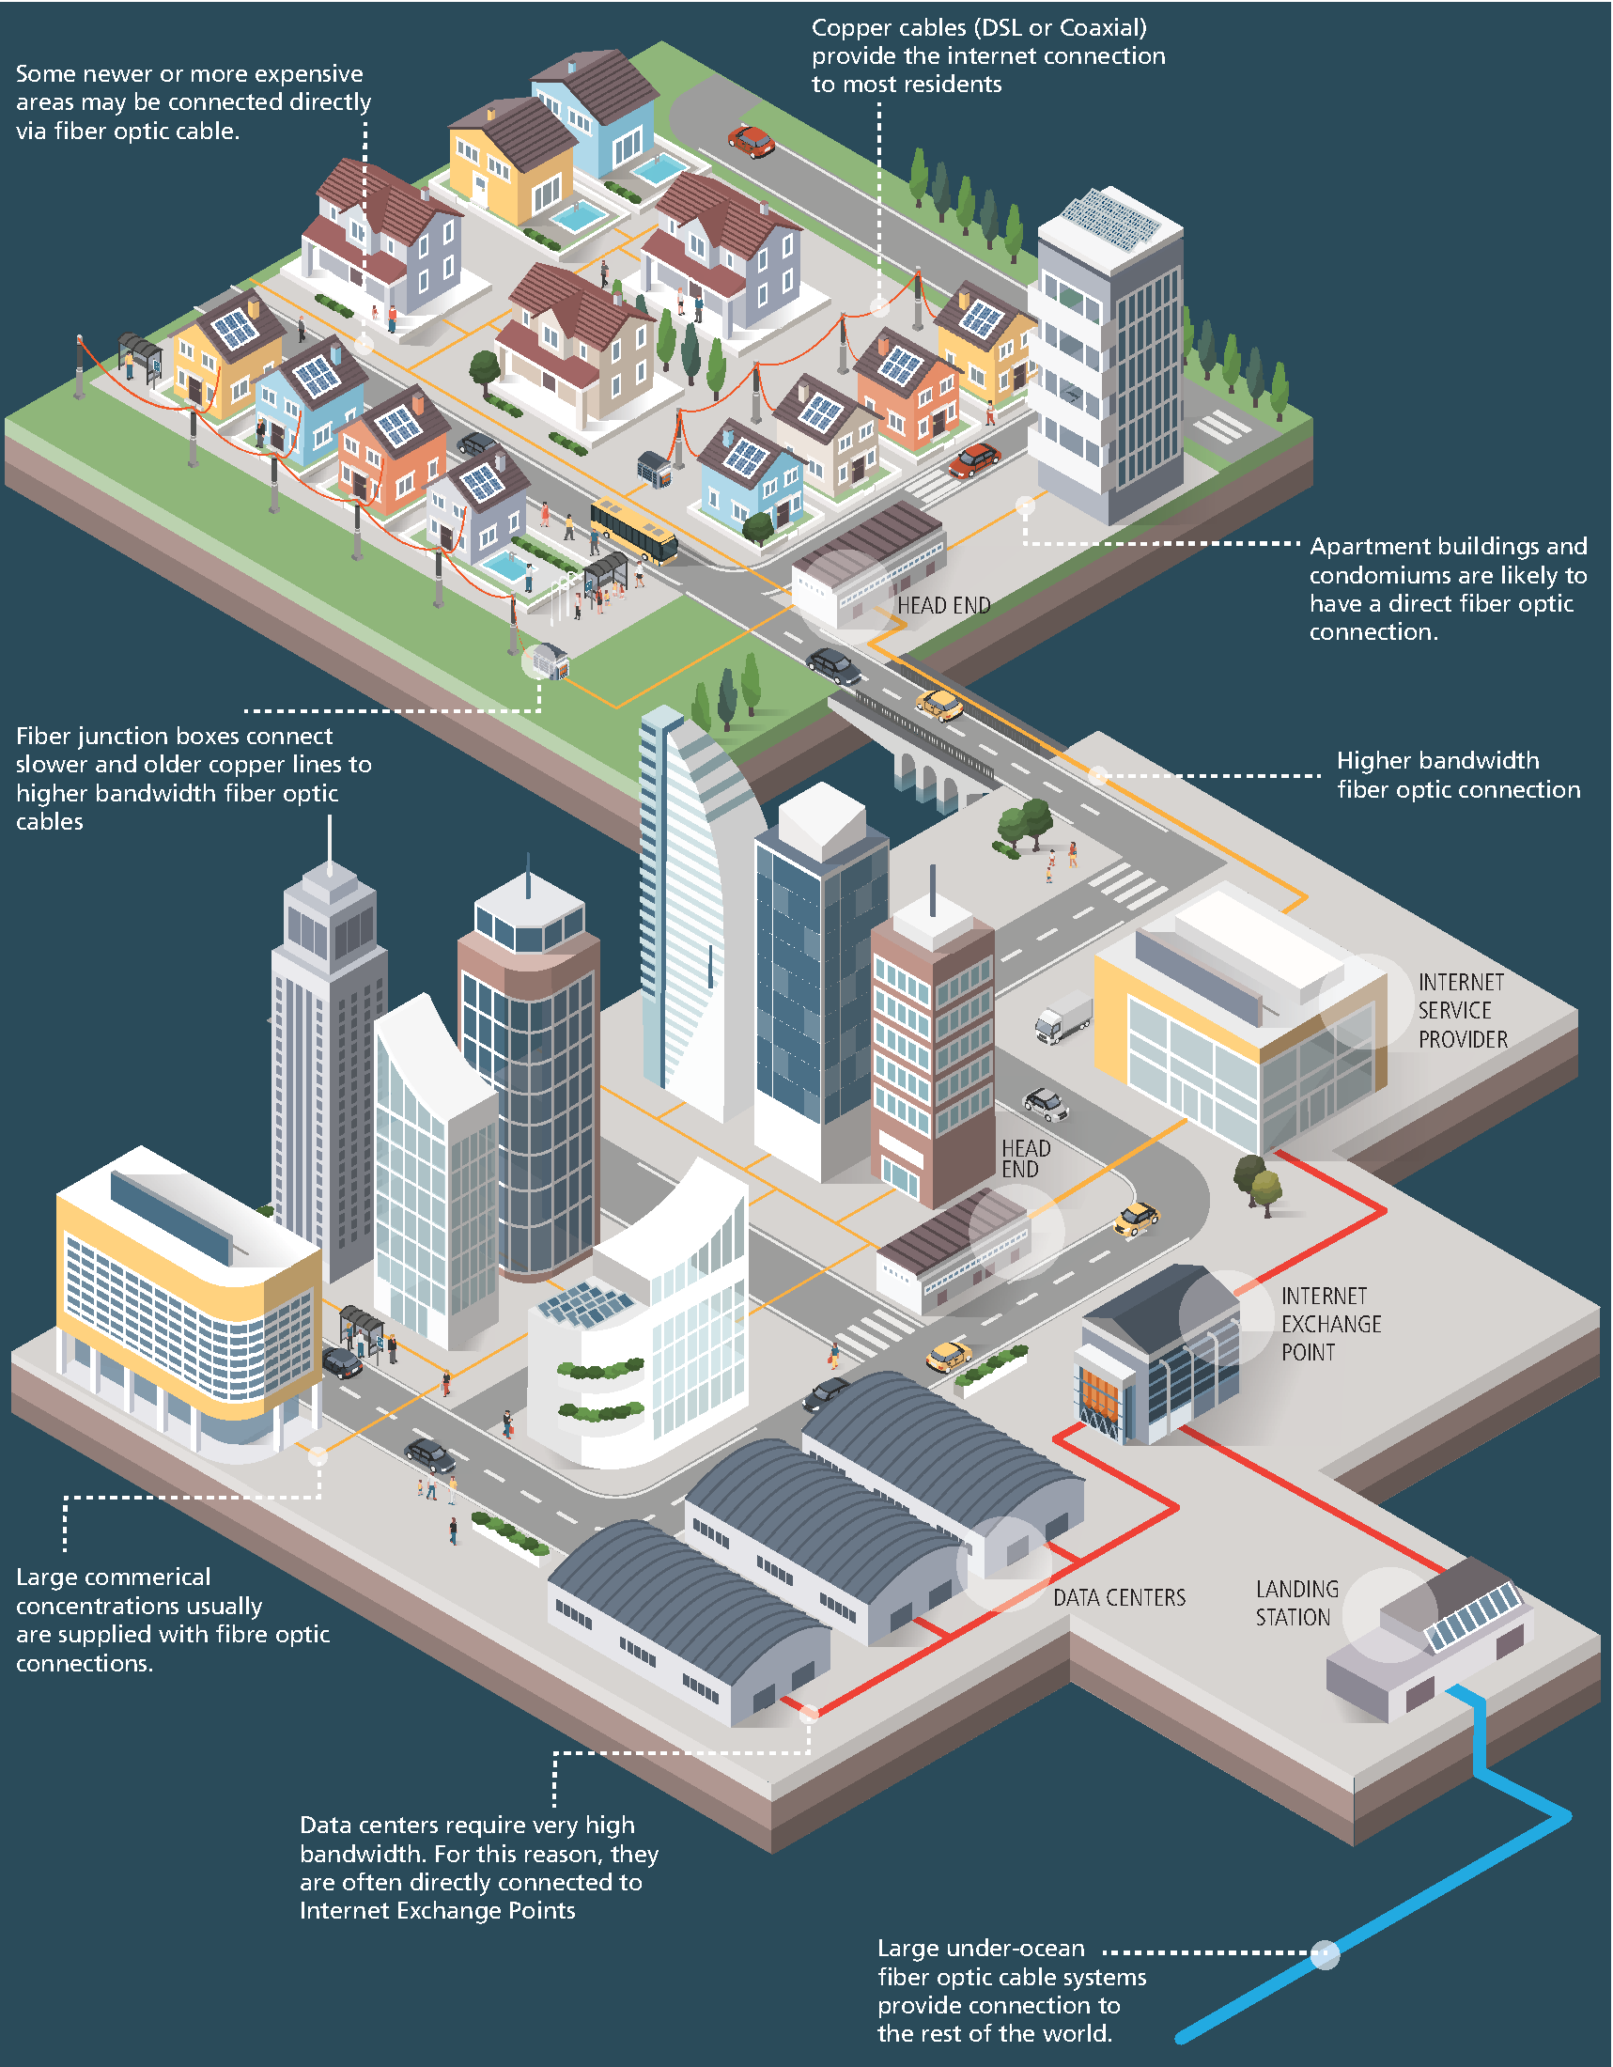
From the Home to the Ocean’s Edge

Slide 25
From the Home to the Ocean’s Edge (2)

Slide 26
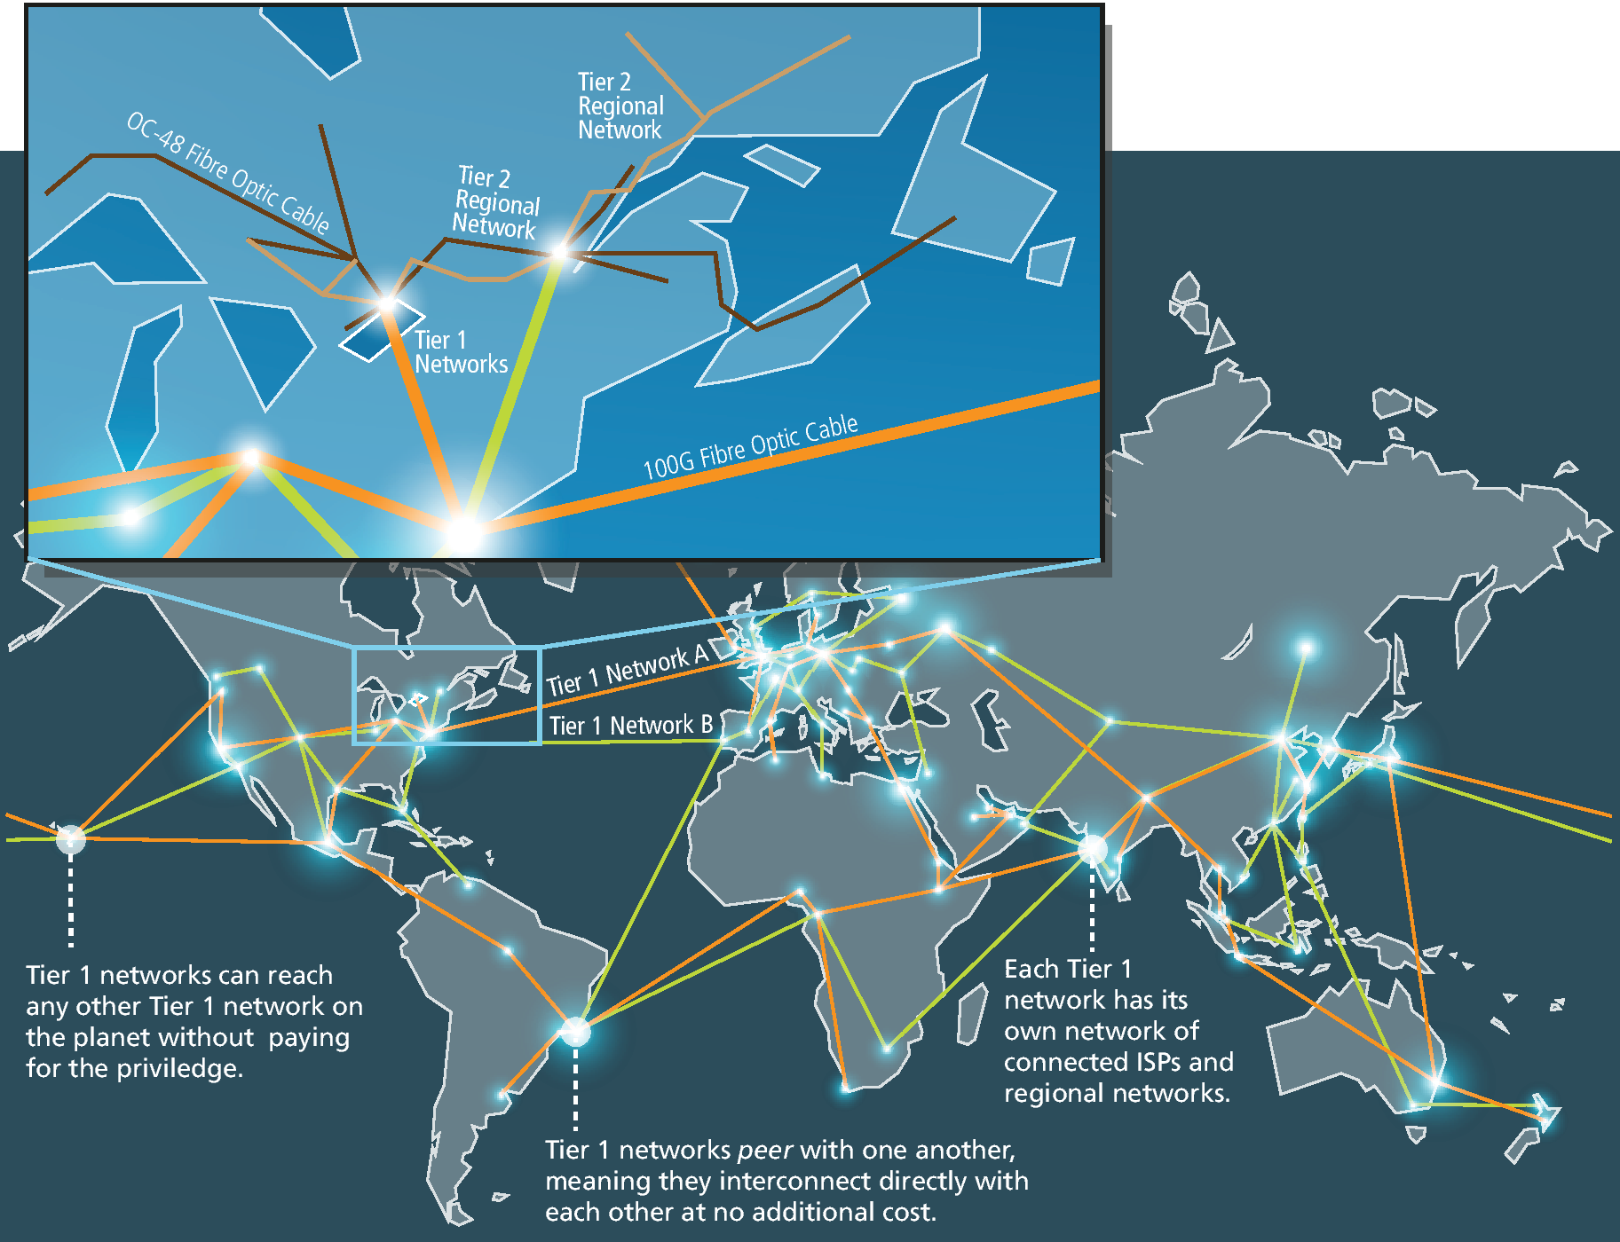
How the Internet Is Organized Today
When someone talks about the “Internet Backbone” they
are talking about Tier 1 networks.
Tier 1 Networks make use of very fast fiber optic cable.
Regional networks have traditionally used less speedy infrastructure, though this is rapidly changing as prices of optical hardware
decreases.

Slide 27
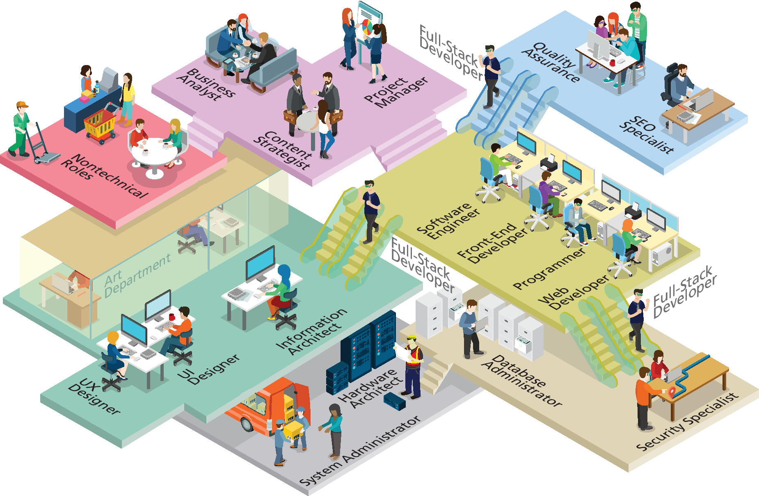
Working in Web Development

Slide 28
Roles in Web Development
Hardware Architect/Network Architect/Systems Engineer
System Administrator
Database Administrator/Data Architect
Security Specialist/Consultant/Expert
Developer/Programmer
Front-End Developer/UX Developer
Software Engineer
UX Designer/UI Designer/Information Architect
Tester/Quality Assurance
SEO Specialist
Content Strategists/Marketing Technologist
Project Manager/Product Manager
Business Analyst
Nontechnical Roles
Full-stack developer

Slide 29
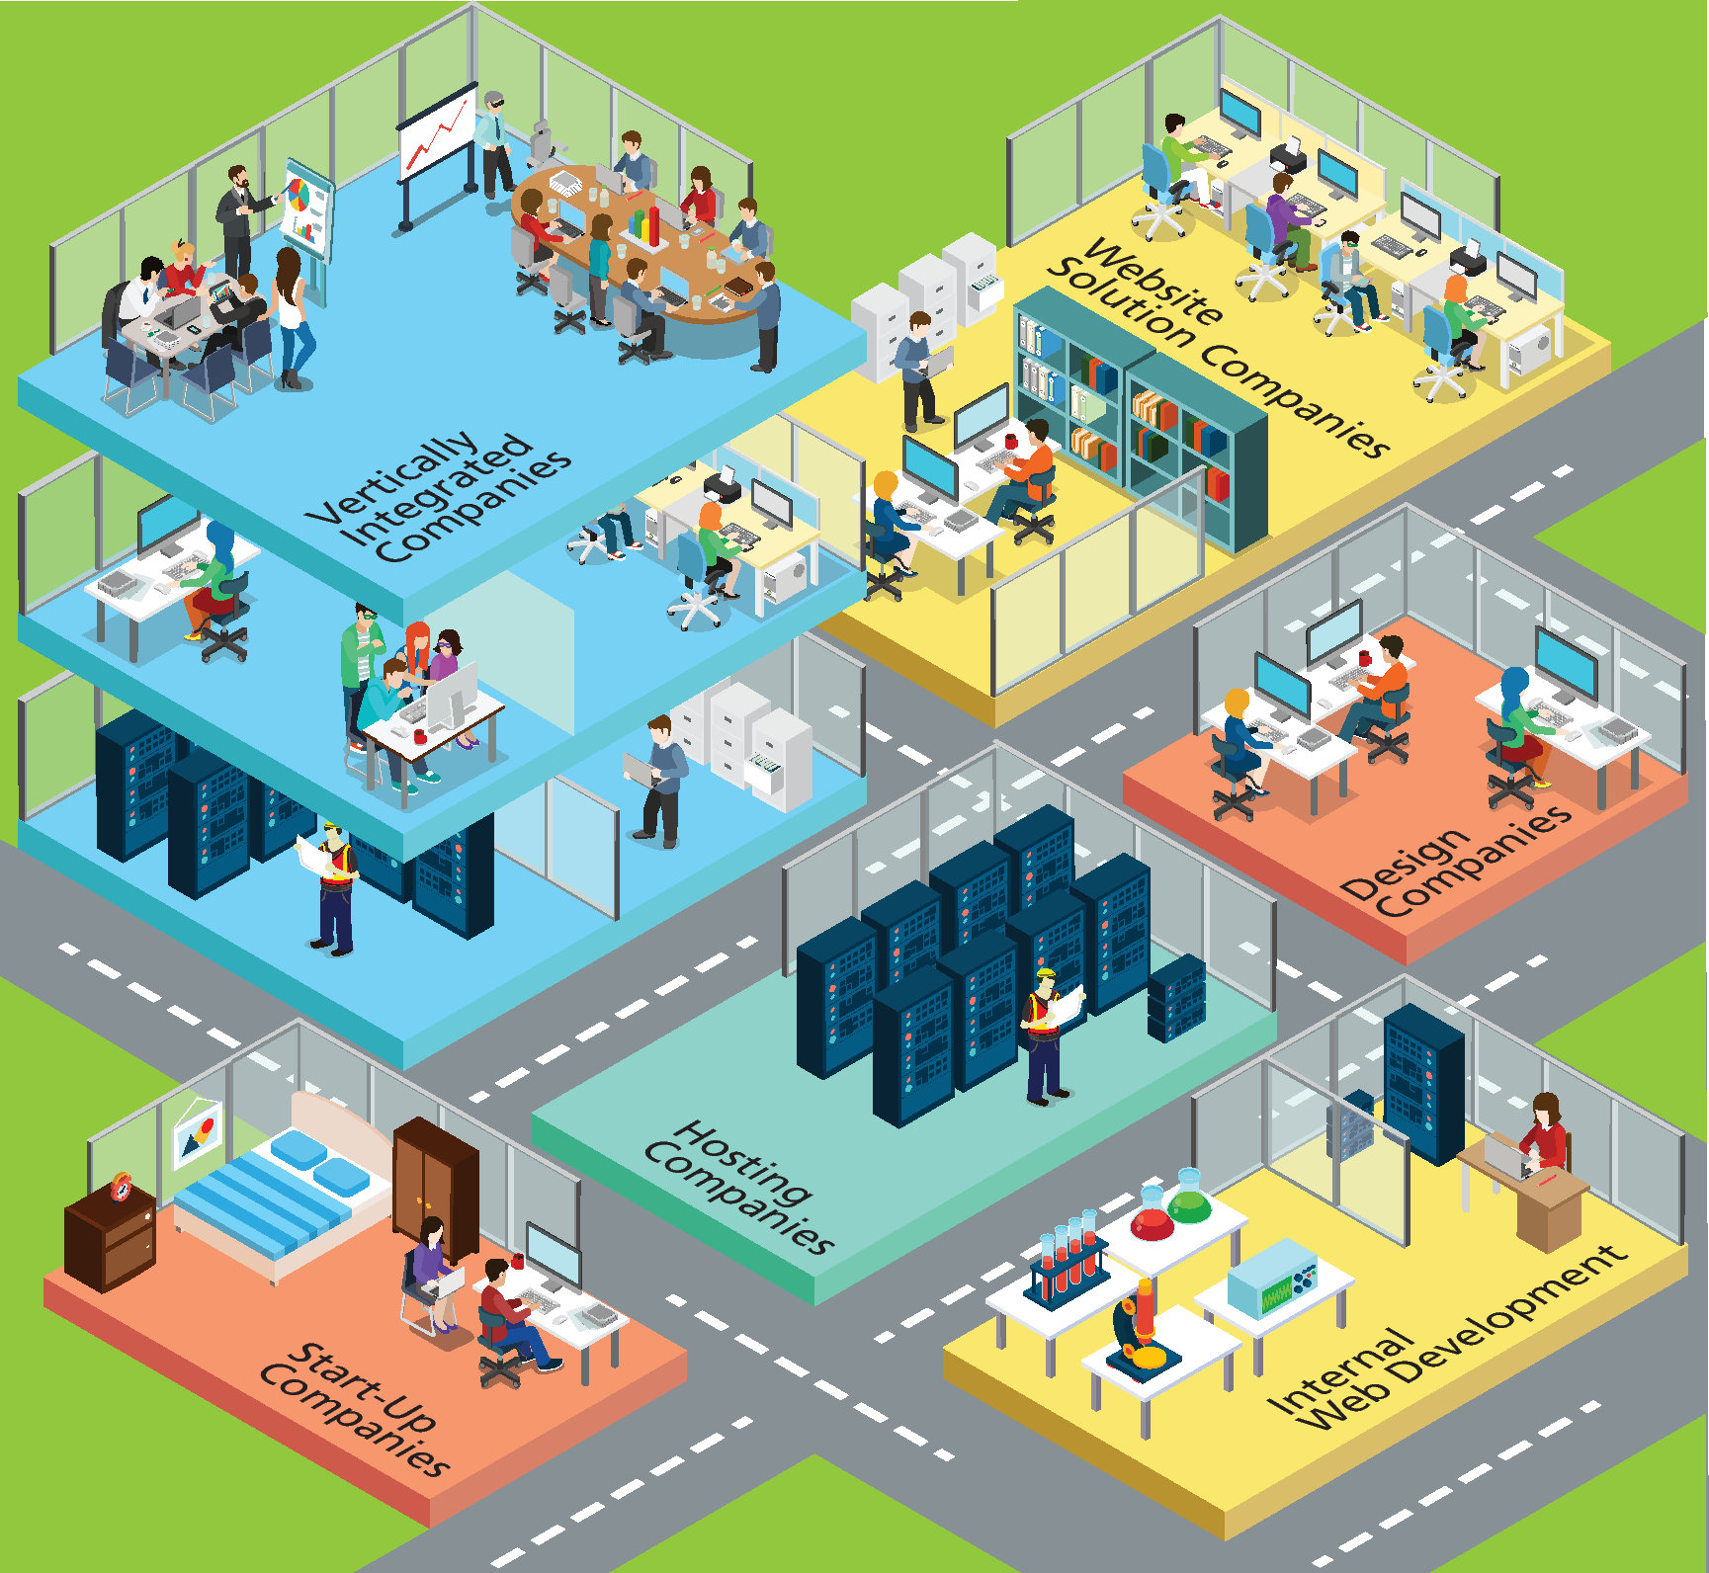
Web Development Companies
Hosting Companies
Design Companies
Website Solution Companies
Vertically Integrated Companies
Start-Up Companies
Internal Web Development

Slide 30
Key Terms
application server
authentication server
back end
bandwidth
broadband modem
circuit switching
client
client-server model
Content Delivery
Networks (CDN)
Content Delivery
Networks (CDN)
data center
database server
DevOps (Development
and Operations)
dynamic server-side
website
elastic provisioning
failover redundancy
fiber optic cable
front end
full-stack developer
intranet
internet
Internet exchange point
(IX or IXP)
Internet service provider
(ISP)
latency
load balancers
mail server
media server
Mosaic
Netscape Navigator
Network Access Points
(NAP)
next-hop routing
packet
packet switching
peer-to-peer model
request
protocols
Request for Comments
(RFC)
request-response loop
response
router
routing table
semantic web
server
server farm
server racks
shared hosting
static website
TCP/IP (Transmission
Control Protocol/
Internet Protocol)
user experience
virtual server
webmaster
web servers
Web 2.0
World Wide Web
Consortium (W3C)

Slide 31

Copyright
This work is protected by United States copyright laws and is provided solely for the use of instructors in teaching their courses and assessing student learning. Dissemination or sale of any part of this work (including on the World Wide Web) will destroy the integrity of the work and is not permitted. The work and materials from it should never be made available to students except by instructors using the accompanying text in their classes. All recipients of this work are expected to abide by these restrictions and to honor the intended pedagogical purposes and the needs of other instructors who rely on these materials.

